Slide 1
Big Data in
Real - Life
Shahriar’s Analytical Academy

Slide 2
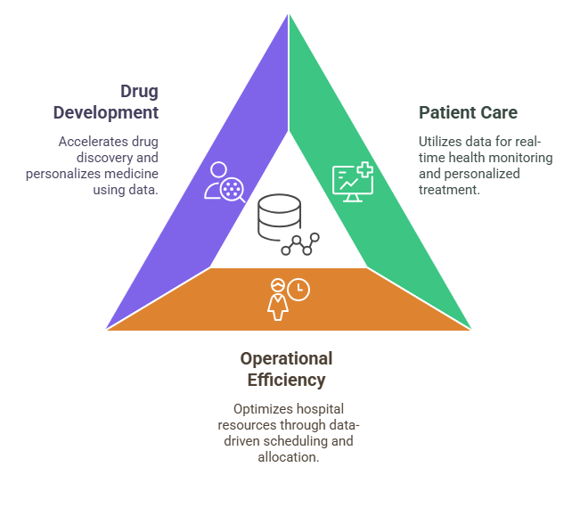
Use of Big Data in Healthcare
In the healthcare industry, big data is used to improve patient care, optimize operations, and enhance research capabilities.
Medical institutions, pharmaceutical companies, and health insurers are adopting big data technologies to leverage vast amounts of healthcare data to improve outcomes and reduce costs.
Notes:
In the healthcare industry, big data is used to improve patient care, optimize operations, and enhance research capabilities. Medical institutions, pharmaceutical companies, and health insurers are adopting big data technologies to leverage vast amounts of healthcare data to improve outcomes and reduce costs.
Patient Care: Hospitals and clinics collect enormous amounts of data from electronic health records (EHRs), medical imaging, and wearables. This data helps in real-time monitoring of patients' health, providing personalized treatment, and detecting early signs of diseases. For example, predictive analytics can identify potential health risks like heart disease, allowing for early interventions.
Operational Efficiency: Hospitals use big data to optimize scheduling, staffing, and resource allocation. By analyzing historical data, hospitals can forecast peak times for patient intake and ensure that resources are effectively distributed.
Drug Development: Pharmaceutical companies use big data to analyze clinical trial data, identify trends, and accelerate drug discovery. Genomic data also allows for more personalized medicine, tailoring treatments to individual genetic profiles.

Slide 3
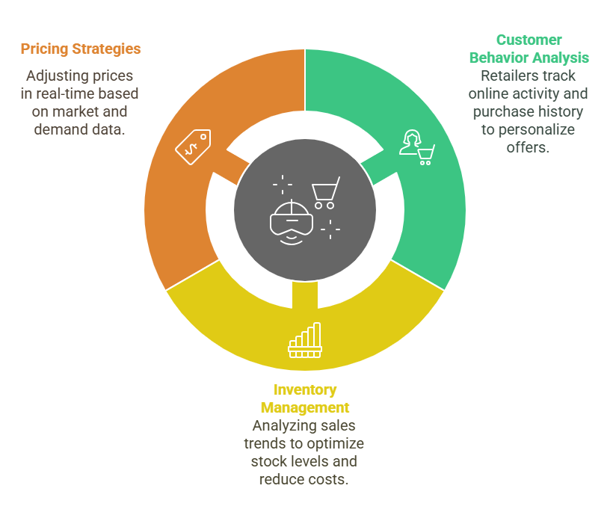
Use of Big Data in E-commerce
Big data has revolutionized the retail and e-commerce sectors by allowing businesses to better understand their customers, personalize marketing efforts, and optimize inventory management.
Notes:
2. Retail and E-commerce
Big data has revolutionized the retail and e-commerce sectors by allowing businesses to better understand their customers, personalize marketing efforts, and optimize inventory management.
Customer Behavior Analysis: Retailers use big data to track customer behavior through online activity, purchase history, and social media interactions. This helps them personalize product recommendations and offers based on individual preferences and purchase patterns. For instance, Amazon uses big data to suggest products based on previous purchases or browsing history.
Inventory Management: Big data helps retailers manage inventory by analyzing sales trends, predicting demand, and reducing overstocking or understocking. This ensures that popular products are always in stock while minimizing unnecessary inventory costs.
Pricing Strategies: Retailers can use dynamic pricing strategies, adjusting prices in real-time based on market conditions, competition, and customer demand. For example, companies like Walmart and Target use big data to offer discounts at optimal times to drive sales while maintaining profitability.

Slide 4
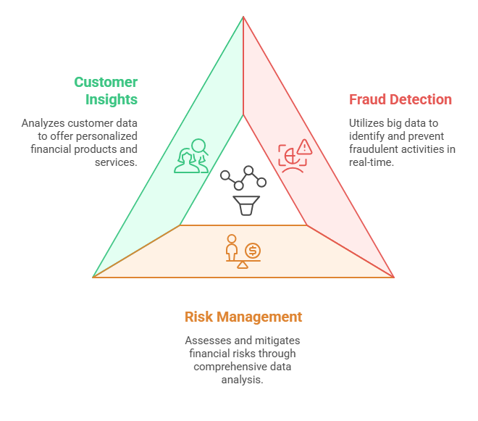
Use of Big Data in Banking
The finance and banking sector uses big data for a variety of purposes, including fraud detection, risk management, customer relationship management, and investment strategies.
Notes:
3. Finance and Banking
The finance and banking sector uses big data for a variety of purposes, including fraud detection, risk management, customer relationship management, and investment strategies.
Fraud Detection and Prevention: Banks and financial institutions utilize big data to monitor transactions and detect fraudulent activities. Machine learning models analyze historical data and flag suspicious activities in real-time, preventing financial crimes like identity theft and credit card fraud.
Risk Management: Financial institutions use big data to assess credit risk, market risk, and operational risk. By analyzing data from various sources, such as market conditions, economic indicators, and customer behavior, companies can make more informed investment decisions and mitigate risks.
Customer Insights: Banks and financial services companies analyze customer data to understand their needs and offer tailored products, such as personalized loans, credit cards, and insurance plans. Big data helps companies improve customer engagement by offering relevant services and predicting customer behavior.

Slide 5
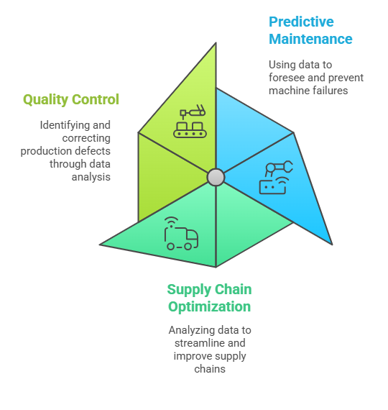
Use of Big Data in Supply Chain
In manufacturing, big data is used to optimize production processes, manage supply chains, and improve product quality. Companies in this sector leverage data analytics to reduce waste, increase efficiency, and innovate new products.
Notes:
4. Manufacturing and Supply Chain
In manufacturing, big data is used to optimize production processes, manage supply chains, and improve product quality. Companies in this sector leverage data analytics to reduce waste, increase efficiency, and innovate new products.
Predictive Maintenance: Manufacturers use big data to monitor equipment and machinery performance in real-time. By collecting data from sensors on the shop floor, companies can predict when a machine will fail and schedule maintenance before costly breakdowns occur, reducing downtime and maintenance costs.
Supply Chain Optimization: Big data helps manufacturers track and optimize their supply chains by analyzing data related to inventory levels, transportation, supplier performance, and customer demand. This enables companies to make faster decisions, reduce delays, and ensure that products reach customers on time.
Quality Control: Data collected from production processes can be analyzed to identify patterns and anomalies that affect product quality. For example, sensors in production lines can detect defects and allow manufacturers to correct issues before they reach customers.

Slide 6
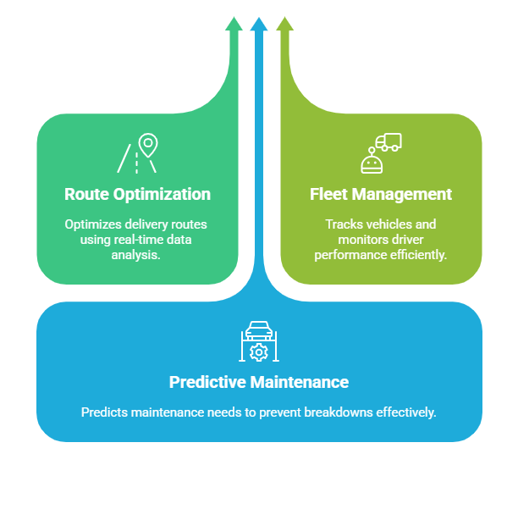
Use of Big Data in Transportation
Big data has transformed the transportation and logistics sector, enabling more efficient route planning, real-time monitoring, and customer service improvements.
Notes:
5. Transportation and Logistics
Big data has transformed the transportation and logistics sector, enabling more efficient route planning, real-time monitoring, and customer service improvements.
Route Optimization: Companies in logistics, such as shipping and delivery services, use big data to optimize delivery routes in real time. By analyzing traffic patterns, weather conditions, and historical data, businesses can reduce fuel costs, improve delivery times, and enhance customer satisfaction. For instance, delivery services like UPS and FedEx use big data for route optimization to ensure timely deliveries.
Fleet Management: Transportation companies use big data to track vehicles, manage fuel consumption, and monitor driver performance. Real-time data from vehicles, including GPS location and speed, helps companies improve fleet efficiency and reduce costs.
Predictive Maintenance: Similar to the manufacturing sector, logistics companies use data from sensors to predict when vehicles or machinery need maintenance, preventing breakdowns and improving operational efficiency.

Slide 7
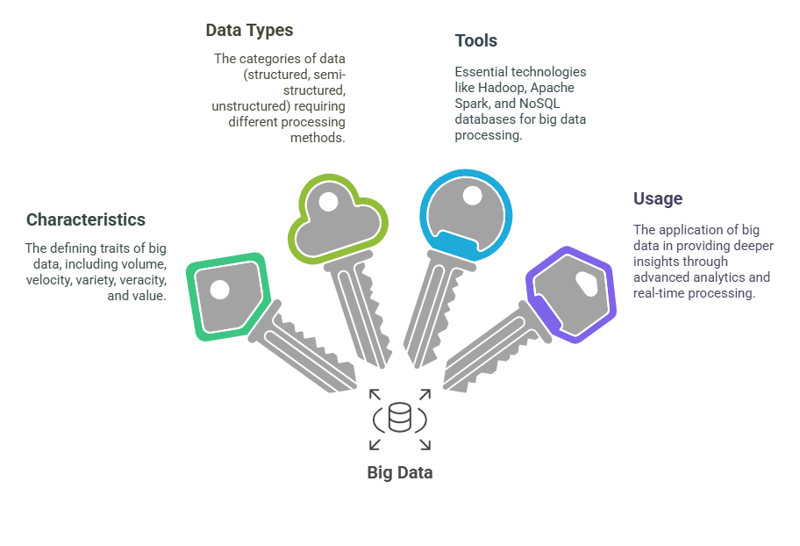
4 Key Learning Points of this Lesson
Notes:
Understanding Big Data Big data refers to massive and complex datasets that are beyond the capacity of traditional data systems to process due to their sheer size, speed, and variety. These datasets often come from a wide range of sources and require specialized tools and techniques for management and analysis.
Key Characteristics of Big Data The five key characteristics of big data are:
Volume: Refers to the huge amount of data being generated.
Velocity: The speed at which data is generated and needs to be processed.
Variety: The different types of data, including structured, semi-structured, and unstructured.
Veracity: The quality and reliability of the data.
Value: The ability to extract meaningful insights from the data.
Types of Big Data Big data comes in three main types:
Structured Data: Organized in predefined formats, easy to process.
Semi-structured Data: Data with some structure but not as rigid, often including tags or markers.
Unstructured Data: Raw, unorganized data such as images, videos, and social media posts that need processing to become useful.
Tools for Big Data Handling and analyzing big data requires specialized tools. These include:
Hadoop: A framework for distributed storage and processing of large datasets.
Apache Spark: A fast data processing engine, especially suited for real-time processing.
NoSQL Databases: Flexible databases like MongoDB and Cassandra, designed for handling unstructured and semi-structured data.
Data Lakes: Large repositories that store raw data in its native format, offering flexibility for future analysis.

Slide 8
Thank You!
Shahriar’s Analytical Academy

